Slide 1
Microsoft Azure App Services: technical deep dive into Web Apps, DNS, TrafficManager and Application Gateway
Alexey Bokov / abokov @ microsoft.com / twitter: @abokov
Senior Program Manager
Technical Evangelist and Development team
Microsoft Corp

Slide 2
Contents
Web application in cloud – end-to-end solution
High availability services
Azure DNS
Traffic Manager
Load Balancing
Application Gateway
Azure Internal Load Balancer
API Management, Mobile App, Logical App
App Services: Web apps
Plans & features
Staging environment
Web jobs

Slide 3
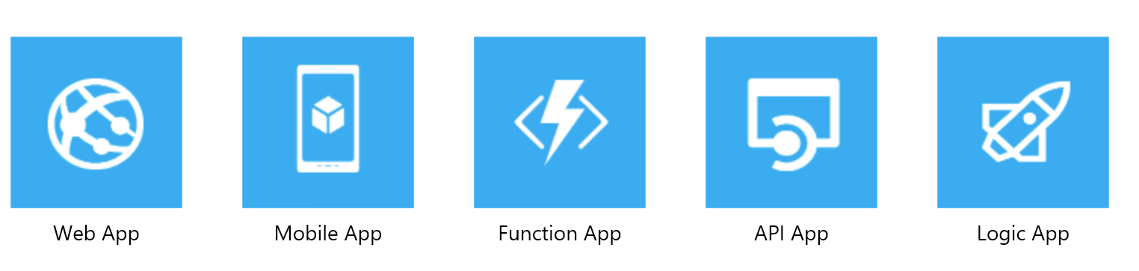
Azure Web application principal scheme
DNS layer
Azure DNS
Traffic Manager (load balancing/health check-DNS layer )
End User
Web app: front-end
Load balancing services:
Azure Load Balancer
Application Gateway (Windows Application Firewall )
http/https
Web app: front-end based on AppServices
Web app: backend
Backend (may include load balancing services as well)
Virtual Machines/Service Fabric/Docker Containers/..
SQL Azure
Hadoop Cluster
NoSQL DB
….

Slide 4
High availability services
DNS level :
Azure DNS
Traffic Manager
Application level:
Azure Internal Load Balancer ( ALB )
Application Gateway
Web Application Firewall (WAF)

Slide 5
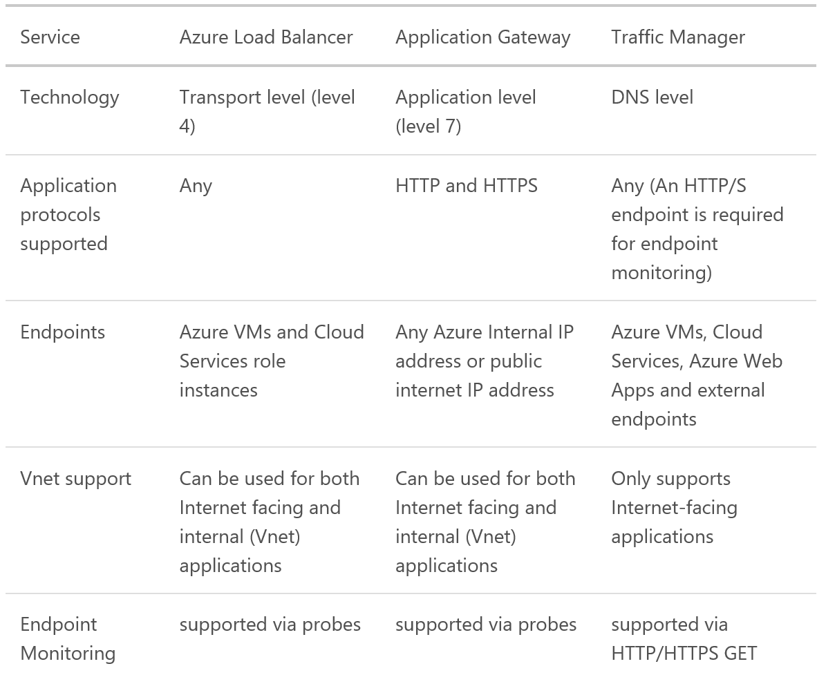
High availability services

Slide 6
Azure DNS
Azure DNS is a hosting service for DNS domains
DNS domains in Azure DNS are hosted on Azure’s global network of DNS name servers.
We use Anycast networking DNS query is answered by the closest available DNS server.
Currently only domain delegation is supported (??)
Azure DNS supports all common DNS record types, including A, AAAA, CNAME, MX, NS, SOA, SRV, and TX, as well as wildcards.
Note: you can buy domain via Azure.com (somewhere I saw Buy button)

Slide 7
Azure Traffic Manager
Works on DNS level, best scenarios:
Improve availability of critical applications
Improve responsiveness for high performance applications – allows you to run cloud services or websites in datacenter (any hosting, not limited to Azure .
Upgrade and perform service maintenance without downtime
Combine on-premises and Cloud-based applications – Traffic Manager supports external, non-Azure endpoints enabling it to be used with hybrid cloud and on-premises deployments, including the “burst-to-cloud,” “migrate-to-cloud,” and “failover-to-cloud” scenarios.
Distribute traffic for large, complex deployments – Traffic-routing methods can be combined using nested Traffic Manager profiles

Slide 8
Azure Traffic Manager
Traffic routing methods available in Traffic Manager:
Priority: Select ‘Priority’ when you want to use a primary service endpoint for all traffic, and provide backups in case the primary or the backup endpoints are unavailable. For more information, see Priority traffic-routing method.
Weighted: Select ‘Weighted’ when you want to distribute traffic across a set of endpoints, either evenly or according to weights which you define. For more information, see Weighted traffic-routing method.
Performance: Select ‘Performance’ when you have endpoints in different geographic locations and you want end users to use the "closest" endpoint in terms of the lowest network latency. For more information, see Performance traffic-routing method.

Slide 9

Azure Traffic Manager: priority routing

Slide 10
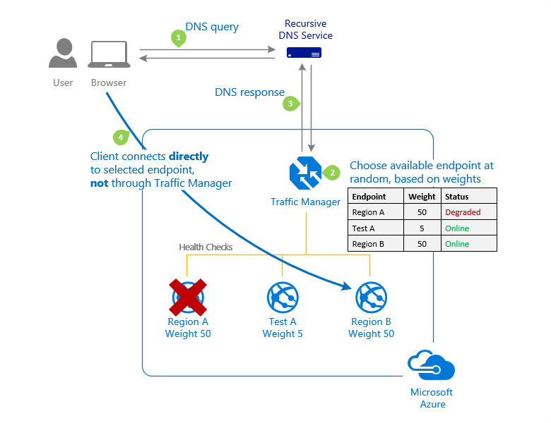
Azure Traffic Manager: weighted routing

Slide 11
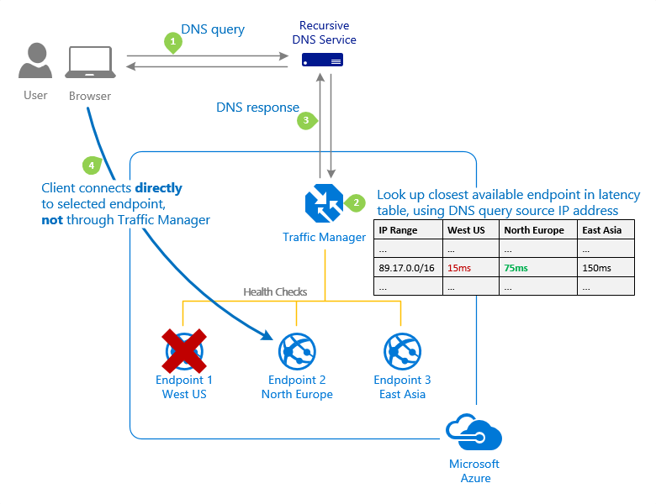
Azure Traffic Manager: performance routing

Slide 12
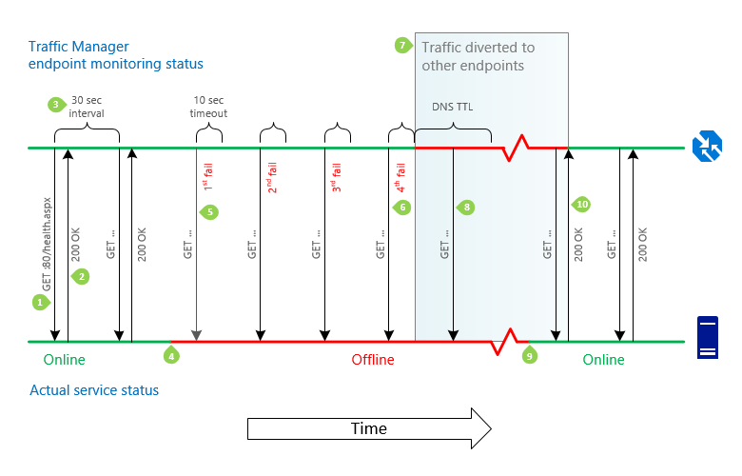
Azure Traffic Manager: example

Slide 13
Azure Internal Load Balancer
Azure Load Balancer delivers high availability and network performance to your applications. It is a Layer 4 (TCP, UDP) load balancer that distributes incoming traffic among healthy instances of services defined in a load-balanced set. o
Azure Load Balancer configuration:
Load balance incoming Internet traffic to virtual machines. This configuration is known as Internet-facing load balancing.
Load balance traffic:
Between virtual machines in a virtual network
between virtual machines in cloud services
between on-premises computers and virtual machines in a cross-premises virtual network ( internal load balancing )
Forward external traffic to a specific virtual machine.
All resources in the cloud need a public IP address to be reachable from the Internet. Within the cloud infrastructure, Microsoft Azure uses non-routable IP addresses for its resources. Azure uses network address translation (NAT) with public IP addresses to communicate to the Internet.

Slide 14
Azure Load Balancer features
Hash-based distribution :
By default, it uses a 5-tuple (source IP, source port, destination IP, destination port, and protocol type) hash to map traffic to available servers.
Stickiness only within a transport session.
Packets in the same TCP or UDP session will be directed to the same instance behind the load-balanced endpoint.
When the client closes and reopens the connection or starts a new session from the same source IP, the source port changes. This may cause the traffic to go to a different endpoint in a different datacenter.
Port forwarding
Automatic reconfiguration during scale up/down
Service monitoring by probes:
Guest agent probe (on PaaS VMs only): utilizes the guest agent inside the virtual machine – check to HTTP 200
HTTP custom probe: Probe your endpoint on instance each 15 sec for TCP ACK or HTTP 200 within the timeout period.
TCP custom probe: relies on successful TCP session establishment to a defined probe port.

Slide 15
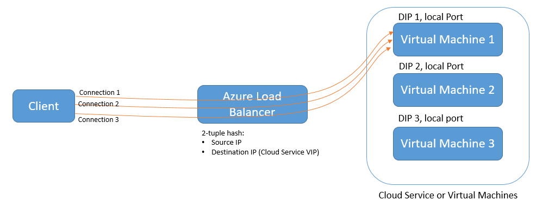
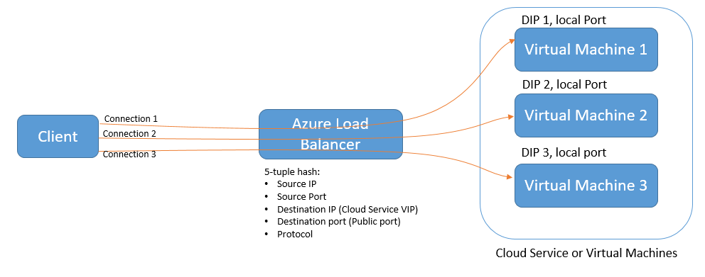
Azure Load Balancer distribution modes
IP Affinity mode: use (Source IP, Destination IP, Protocol) to map traffic
Hash based mode: use (source IP, source port, destination IP, destination port, protocol type) hash to map traffic, stickiness only within a transport session

Slide 16
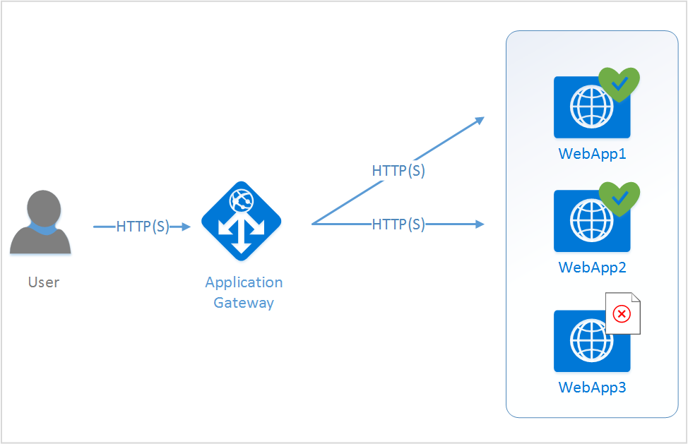
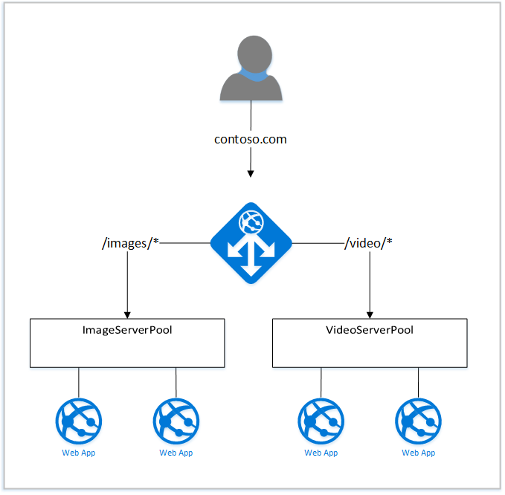
Azure Application Gateway
Requests balancing/routing, firewall features and health checking

Slide 17
Azure Application Gateway
Application Gateway currently supports layer-7 application delivery for the following:
HTTP load balancing
Cookie-based session affinity
Secure Sockets Layer (SSL) offload
URL-based content routing
Multi-site routing
HTTP layer 7 load balancing is useful for:
Applications that require requests from the same user/client session to reach the same back-end virtual machine.Examples of these applications would be shopping cart apps and web mail servers.
Applications that want to free web server farms from SSL termination overhead.
Applications, such as a content delivery network, that requires multiple HTTP requests on the same long-running TCP connection to be routed or load balanced to different back-end servers.
Application Gateway available in 3 sizes : Small ( on for dev/qa ), Medium, Large.

Slide 18
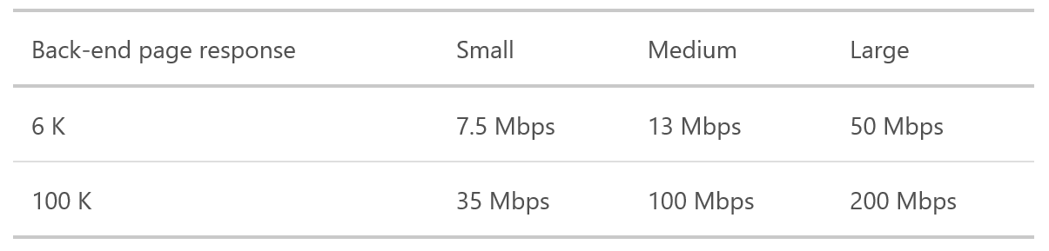
Azure Application Gateway
The following table shows an average performance throughput for each application gateway instance:

Slide 19
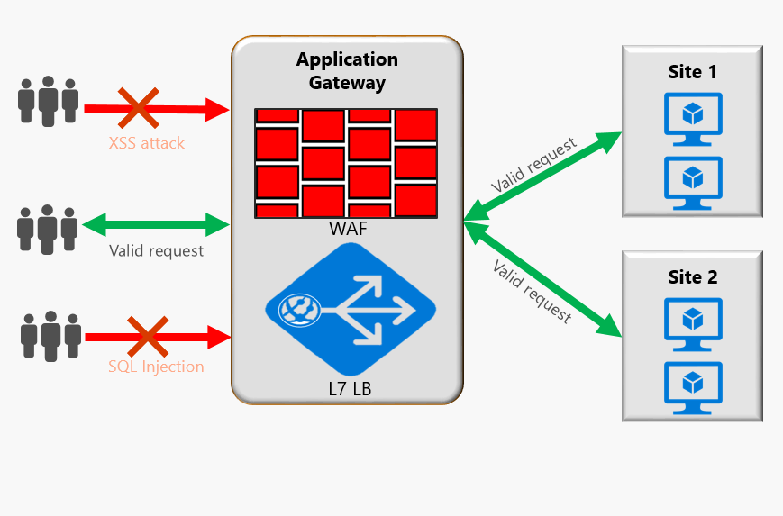
Azure Application Gateway: Web Application Firewall (WAF )

Slide 20
Web Application Firewall
Baseline protection against most of the OWASP top 10 common web vulnerabilities.
SQL injection protection
Cross site scripting protection
Common Web Attacks Protection such as command injection, HTTP request smuggling, HTTP response splitting, and remote file inclusion attack
Protection against HTTP protocol violations
Protection against HTTP protocol anomalies such as missing host user-agent and accept headers
HTTP DoS Protections including HTTP flooding and slow HTTP DoS prevention
Prevention against bots, crawlers, and scanners
Detection of common application misconfigurations (i.e. Apache, IIS, etc)
OWASP = Open Web Application Security Project - owasp.org/

Slide 21
Web Application Firewall
Application Gateway WAF can be configured to run in the following two modes:
Detection mode – WAF monitors and logs all threat alerts into a log file:
Logging diagnostics for Application Gateway should be ON in Diagnostics section.
WAF log is selected and turned ON
Prevention mode – blocks intrusions and attacks detected by its rules:
The attacker receives a 403 unauthorized access exception and the connection is terminated.
Prevention mode continues to log such attacks in the WAF logs.
Another option for Firewall is to use Barracuda application firewall in front of web facing apps.

Slide 22
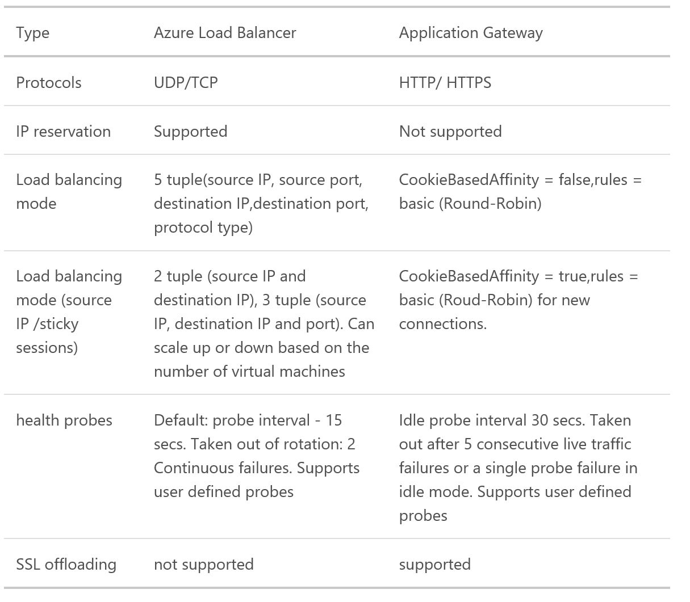
Application Gateway vs Load Balancer

Slide 23
Azure App Services

Slide 24
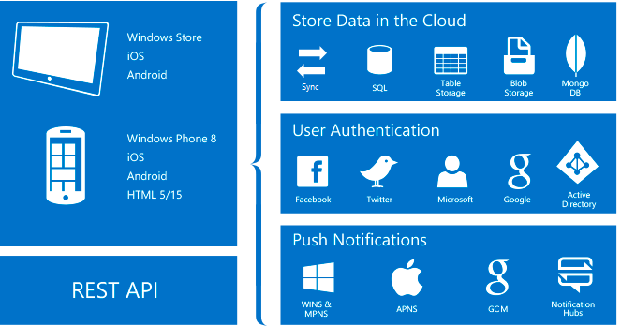
AppServices: Mobile Apps
Authentication and Authorization - based on Oauth 2.0:
Azure Active Directory for enterprise authentication, Facebook,
Google, Twitter, Microsoft Account…
Data Access - OData v3 data source linked to SQL Azure/on-premises SQL Server. Entity Framework with integration to noSQL and SQL data providers, including Azure Table Storage, MongoDB, DocumentDB and SaaS API providers like Office 365 and Salesforce.com.
Offline Sync - Our Client SDKs helps to build apps that operate with an offline data set that can be automatically synchronized with the backend data, including conflict resolution support.
Push Notifications – Azure Notification Hubs, allowing you to send push notifications to millions of users simultaneously.
Client SDKs - Native development (iOS, Android, Windows), cross-platform development (Xamarin for iOS and Android, Xamarin Forms) and hybrid application development (Apache Cordova). Each client SDK is available with an MIT license and is open-source.

Slide 25
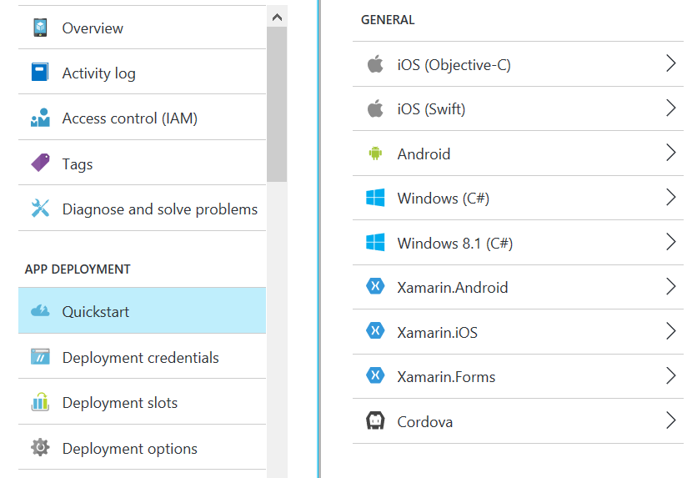
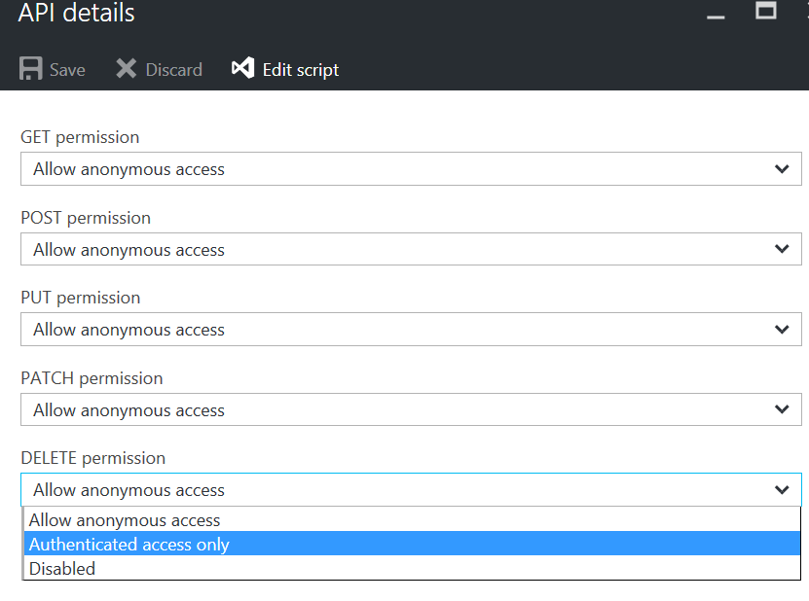
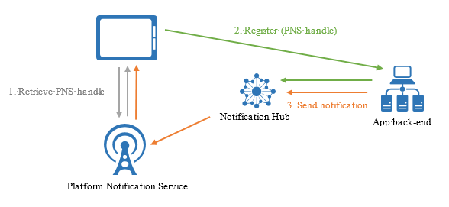
App Services: Mobile Apps
Built-in portal features – quick start templates for client apps
Easy management for API calls and handlers
Integration with Notification Hub to manage Push notifications

Slide 26
Azure Notification Hub
Multiple platforms:
Support for all major mobile platforms
Common interface to send notifications to all supported platforms.
Device handle management.
Works with any back-end: Cloud or on-premises, any programming language .NET, PHP, Java, Node…
Scale: Notification hubs scale to millions of devices without the need to re-architect or shard.
Rich set of delivery patterns:
Broadcast: allows for near-simultaneous broadcast to millions of devices with a single API call.
Unicast/Multicast: Push to tags representing individual users, including all of their devices; or wider group; for example, separate form factors (tablet vs. phone).
Segmentation: Push to complex segment defined by tag expressions (for example, devices in New York following the Yankees).
Personalization: Each device can have one or more templates, to achieve per-device localization and personalization without affecting back-end code.
Security: Shared Access Secret (SAS) or federated authentication.
Rich telemetry: Available in the portal and programmatically.

Slide 27
AppServices: Management API
Reuse. Support legacy APIs without rewriting them
Access without headaches. Provide developers with access to APIs easily and automatically
Security. Secure backend systems and protect APIs against rogue use or overuse
Visibility. Measure which APIs are being used, how much, and by whom
API gateway:
Accepts API calls and routes them to your backends.
Verifies API keys, JWT tokens, certificates, and other credentials.
Enforces usage quotas and rate limits.
Transforms your API on the fly without code modifications.
Caches backend responses where set up.
Logs call metadata for analytics purposes.
Publisher portal is the administrative interface where:
Define or import API schema, package APIs into products.
Set up policies like quotas or transformations on the APIs.
Get insights from analytics
Manage users.
Developer portal :
Try out an API via the interactive console.
Create an account and subscribe to get API keys.

Slide 28
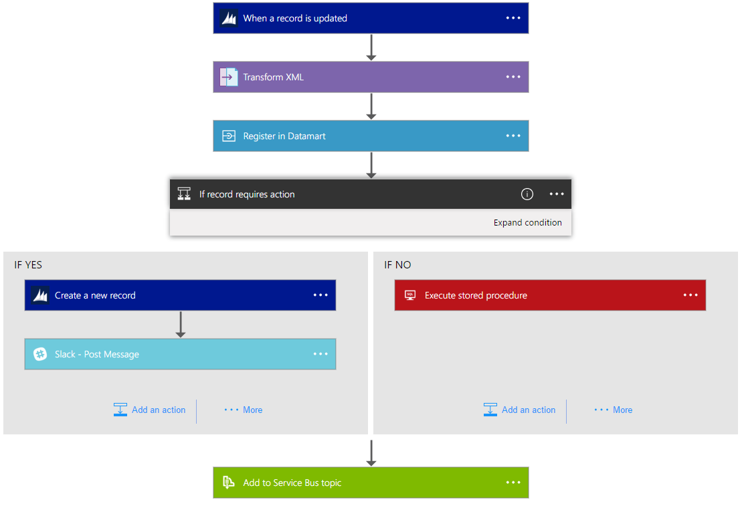
App Services: Logic Apps
Logic Apps - way to simplify and implement scalable integrations and workflows in the cloud.
It provides a visual designer to model and automate your process as a series of steps i.e. workflow.
Workflow - Logic Apps provides a graphical way to model your business processes as a series of steps or a workflow.
Managed Connectors - Your logic apps need access to data and services.
Triggers - starts a new instance of a workflow based on a specific even
Actions - Each step after the trigger in a workflow is called an action.
Enterprise Integration Pack - For more
advanced integration scenarios, Logic Apps
includes capabilities from BizTalk.

Slide 29
App Service plans
Recommended for try/dev/test or personal usage.
Free = try for free
Basic = host very basic applications
Shared = more advanced for dev/test
Recommended for commercial production workloads
Standard = Go live with web and mobile
Premium = Enterprise scale and integration
 | Free | Basic | Shared | Standard | Premium
Number of apps | 10 | 100 | Unlimited | Unlimited | Unlimited
Disk space | 1 GB | 1 GB | 10 GB | 50 GB | 500 GB
Max instances | -- | -- | Up to 3 | Up to 10 | Up to 50
SLA | -- | -- | 99.95% | 99.95% | 99.95%
Auto scale | -- | -- | -- | Supported | Supported
Geo-distributed environment | -- | -- | -- | Supported | Supported
VPN connectivity | -- | -- | -- | Supported | Supported

Slide 30
App Service plans: continue
 | Free | Basic | Shared | Standard | Premium
Custom domain | 10 | 100 | Unlimited | Unlimited | Unlimited
SSL certificates | -- | -- | Unlimited SNI SSL certs | Unlimited SNI SLL + 1 IP SSL included | Unlimited SNI SLL + 1 IP SSL included
Auto backups/day | -- | -- | Up to 3 | Up to 10 | Up to 50
Active mobile devices | 500 / day | 500 / day | Unlimited | Unlimited | Unlimited
Offline sync/day | 500 calls | 1k calls | 1k calls | Unlimited | Unlimited
Staging environment | -- | -- | -- | 5 | 20

Slide 31
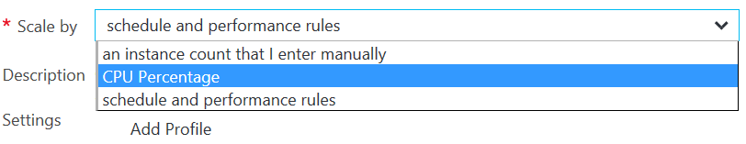
App Service plans: continue
Autoscale : by schedule or automatically by CPU level (average for all instances!).
Geo-distributed environment: You can use different geo-locations for web-sites under same Service Plan.
VPN: Site-to-Site and Point-to-Site VNETs connection
Auto backups: backup App configuration, file content and Azure SQL Database/Azure MySQL connected to app, into storage account by schedule.
Active mobile devices: related to push/call notifications for mobile devices via Notification Hub.
Offline sync: sync for mobile apps under Azure Mobile Apps, for offline mode.
Staging environments: support for staging, including split requests for different environments in the same time

Slide 32
Azure Websites Features & Capabilities
Enterprise-class
Designed for secure mission-critical applications
Global scale
Optimized for Availability and Automatic scale
Built for DevOps
Agility through Continuous Deployment
Hybrid Connections / VPN Support
Scheduled Backup
Azure Active Directory Integration
Site Resiliency, HA, and DR
Web Jobs
Role Base Access Control
Audit / Compliance
Enterprise Migration
Client Certs
Redis Caching
IP Restrictions/ SSL
Web Sockets
SQL, MySQL, DocDB, & Mongo
Automated Deployment AutoScale
Built-in Load Balancing
WW Datacenter Coverage
End Point Monitoring & Alerts
App Gallery
DR Site Support
WildCard Support
Dedicated IP address
HTTP Compression
WebJobs
Sticky Sessions
Remote Debugging w/ Visual Studio
Site Staging Slots
Testing in Production
Continuous Integration/Deployment
Git, Visual Studio Online and GitHub
App & Site Diagnostics
OS & Framework Patching
Site Extensions Gallery
NET, PHP, Python, Node, Java
Framework Installer
Browser-based editing
Auto-Healing
Logging and Auditing
Notes:
Customers are enterprises (mostly .com) agencies, Microsoft. A lot of traction on CMS and WP.
Car companies do digital marketing campaigns, MSFT does blogs.
MSIT looking at using Hybrid Connections for business apps. Good traction with Nordstrom on e-commerce

Slide 33
I- Development and Deployment
Staged Publishing
traffic
traffic
Production
swap
Production
Staging
Developer
Developer

Slide 34
I- Development and Deployment
Testing in Production
100% production.com
Production
swap
Staging
Developer

Slide 35
I- Development and Deployment
Testing in Production
80% production.com
Production
20% production.com
swap
Staging
Developer

Slide 36
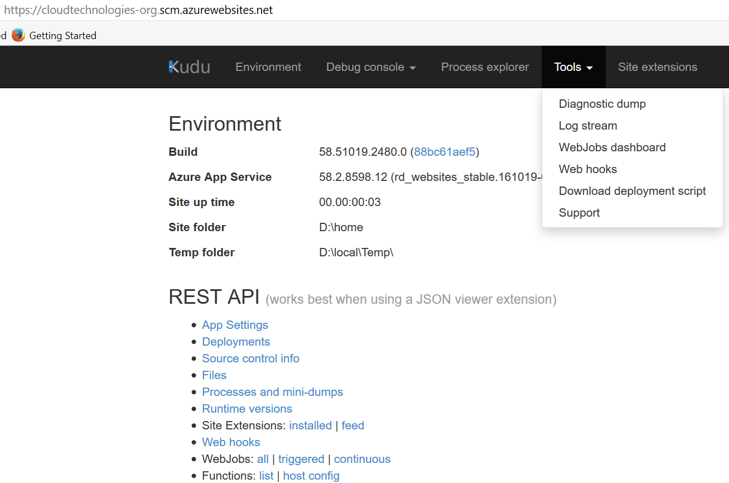
II- Debugging and Investigations
Kudu
https://<mySite>.scm.azurewebsites.net/
* Authenticated
* Runs in the same security
context as the main site
* Can access the site files and
environment variables
* Great for admin and debugging

Slide 37
III- Management and Administration
Azure Portal(s)
Visual Studio
Azure API
Azure Web Site
IIS Manager
xplat CLI
PowerShell

Slide 38
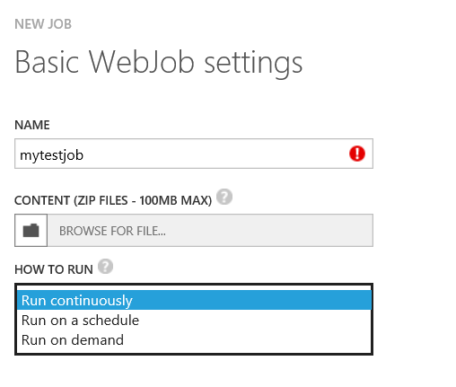
Создание webjobs
Через ftp :
Для triggered job копируем все в путь (внутри вебсайта): site/wwwroot/app_data/jobs/triggered/{job name}
Для continuous job копируем все в путь (внутри вебсайта): site/wwwroot/app_data/jobs/continuous/{job name}
Используя SDK REST API
(например PUT /api/zip/site/wwwroot/App_Data/jobs/continuous/{job name}/ )
Через портал azure.com – загружаем zip файл

Slide 39
Процесс выполнения webjobs
Архив распаковывается во временную папку ( путь к ней в переменной %WEBJOBS_PATH% )
Сначала выполняется поиск файла по маске run.{file type extension} (например run.cmd или run.exe )
Если ничего не найдено для всех типов файлов, то тогда выполняется поиск первого файла с поддерживаемым расширений в указанном порядке: .cmd, .bat, .exe, .ps1, .sh, .php, .py, .js
Поиск выполняется только в корневой папке
Реомендованное имя файла для запуска задач = run.cmd
.cmd, .bat, .exe (using windows cmd)
.ps1 (using powershell)
.sh (using bash)
.php (using php)
.py (using python)
.js (using node)
.jar (using java)

Slide 40
Размещение внутри сайта
Файловая система: site\wwwroot\App_Data\jobs\{job type}\{job name}
Снаружи (через POST) https://{sitename}.scm.azurewebsites.net/api/webjobs/triggered/{webjobname}/run
Веб интерфейс: https://{sitename}.scm.azurewebsites.net/azurejobs/#/jobs
Данные веб-сайта доступны: d:\home ( %HOME% )
При запуске WebJobs копируется во временную папку ( см %WEBJOBS_PATH% ) и там запускается
Для хранения и обработки данных рекомендуется использовать папку:
%WEBROOT_PATH%\App_Data\jobs\%WEBJOBS_TYPE%\%WEBJOBS_NAME%
или %WEBJOBS_DATA_PATH%
Настройки конфигурирования (GET) : https://{sitename}.scm.azurewebsites.net/api/webjobs

Slide 41
Настройки
WEBJOBS_RESTART_TIME – время рестарта в секундах, после завершения предыдещего запуска ( независимо от статуса завершения ) – только для continuous jobs
WEBJOBS_IDLE_TIMEOUT – время бездействия в секундах, при превышении этого времении задача будет принудительно остановлена. Бездействие определяется по отсутствию нагрузки на CPU и операциям ввода-вывода на консоль/логи. Только для triggered jobs
WEBJOBS_HISTORY_SIZE – размер истории запусков, только для triggered jobs
WEBJOBS_STOPPED – если установлено в 1, то запуск задач запрещен и все задачи (включая уже запущенные ) принудительно останавливаются.

Slide 42
Управление остановкой задач
В ряде случаев требуется принудительная остановка задачи и в этом случае существуем механизм сообщения задаче о такой остановке перед тем как она будет удалена.
Это может происходить в случаях:
Рестарта/остановки/изменение настроек веб-сайта/web.config
Остановки задачи ( через API )
Обновления файлов webjob
Как это работает:
Continuous : если требуется принудительная остановка то создается файл %WEBJOBS_SHUTDOWN_FILE% и задаче дается 5 секунд на остановку. Соответственно внутри задачи должен быть мониторинг наличия этого файла как флага принудительной остановки через 5 секунд
Triggered: по умолчанию 30 секунд ожидания

Slide 43
Управление запуском через settings.job
Этот файл должен находится в корневой папке там же где и выполняемый файл.
По умолчанию для всех задач ( кроме .JS ) при каждом запуске выполняется копирование всех файлов в %TEMP%\jobs\{job type}\{job name}\{random name} где и происходит запуск задачи.
Вторая опция называется in place – при этом запуск производится в том же месте где выложен код webjobs ( wwwroot/app_data/job,…. ) Это устанавливается в settings.job при помощи { "is_in_place": true }
Дополнительно в этом файле можно менять время ожидания принудительно остановки задач
{ "stopping_wait_time": 60 }

Slide 44
Переменные окружения
Variable name | Description | Example
HOME | Web site root directory | D:\home
WEBJOBS_DATA_PATH | Job data directory | D:\home\data\jobs\type\name.
WEBJOBS_NAME | Job name
WEBJOBS_PATH | Temporary directory, where job is running | C:\DWASFiles\Sites\~1sitename\Temp\jobs\type\name\lpej4hrk.fks
WEBJOBS_RUN_ID | An unique ID of the job run (an UTC timestamp of the run). There’s a data folder created for every run in %WEBJOBS_DATA_PATH%\%WEBJOBS_RUN_ID% | 201409090707416329
WEBJOBS_TYPE | Job type | triggered or continuous
WEBROOT_PATH | Web site root directory | D:\home\site\wwwroot
WEBSITE_SITE_NAME | Web site name

Slide 45
Пример
@echo off
set LOG=%WEBJOBS_DATA_PATH%\%WEBJOBS_RUN_ID%\session.log
echo WEBJOBS_PATH is %WEBJOBS_PATH%
echo Running script... >> %LOG%
date >>%LOG%
set RESULT=%ERRORLEVEL%
echo Result code is %RESULT%
rem Dumping session log to Azure log (standard output) when it exists
if exist %LOG% (
echo Session log:
type %LOG%
)
rem Propagating exit code to Azure
exit %RESULT%

Slide 46
Failover – main hosting on-premise, Azure- backup
Azure DNS:
*.cloudtechnologies.org CNAME cloudtechnologies-org.trafficmanager.net
Azure Traffic Manager profile:
DNS layer: cloudtechnologies-org.trafficmanager.net Priority Routing (failover )
Endpoint list:
default (priority 1) - External (on-premise) hosting: infobox.cloudtechnologies.org ( IP = 92.243.94.73 )
1st backup (priority 2) – Azure Web App: cloudtechnologies-org.azurewebsites.net
2nd backup ( priority 3) – Azure Linux Web App: cloudtech-org-linux-php.azurewebsites.net

Slide 47
Application gateway load balancing
Azure DNS:
gateway.cloudtechnologies.org A record = 52.164.244.33
Azure Application Gateway ( Web Application Firewall is ON )
URL= 52.164.244.33 ( 68a951a5-e787-4cd5-a2a3-4f8e1ce2bfc1.cloudapp.net )
Backend pool (appGatewayHttpListener with rule1 (no Cookie affinity, 80)):
InfoBox hosting: infobox.cloudtechnologies.org ( DNS A record IP = 92.243.94.73 )

